Slide 1

Quantum Information and Gates
Madhav Jivrajani
Co-founder QForest,
PES University, Bangalore

Slide 2
What is computing?
What does it mean to “compute” something?
Does it come at a cost?
Is it a physical process?
Can we quantify the outcome of computing something?

Slide 3
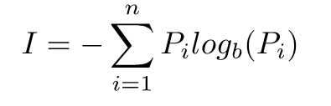
What is computing?
Scary math formula
Shannon’s Equation

Slide 4
What is computing?
Let’s sprinkle some physics on this
Unorganized Organized

Slide 5
Quantum…? Bits…?
Quantum mechanics is as powerful as it is weird. So, how can we use this to our benefit? Much after the advent of quantum mechanics, someone thought, “Oh. What if we use quantum mechanical systems for processing of information?”

Slide 6
Bits! But...quantum?
Classical bits or just bits can have two distinct states, 0 or 1.
Entropy!
Quantum bits on the other hand can be 0 or 1 or anything in-between!
This is possible because of the property of quantum systems called superposition.
Formally… A qubit is a quantum system which represents the smallest unit of quantum information

Slide 7

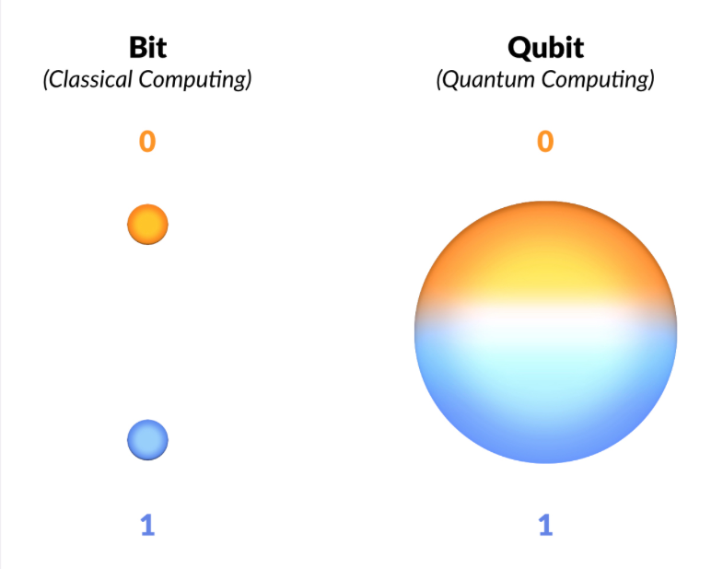
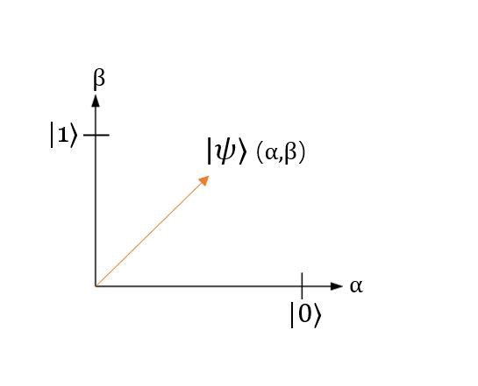
Ohhhh, quantum bits!

Slide 8

Qubits
If you have n qubits then you have 2^{n} computational power
Can any vector be a qubit?

Slide 9
Vectors and Vector Spaces
The generic definition is that, vectors are mathematical objects that have both magnitude and direction.
A vector space over a field F is a set of objects (vectors), where two conditions hold
The operation to add two vectors is closed
The operation of multiplying a vector with a scalar is closed
We represent qubits as “state vectors”
There are simply vectors, no different than the one just presented that point to a specific point in space that corresponds to a particular quantum state. Oftentimes, this is visualized using a Bloch sphere. For instance, a vector, representing the state of a quantum system could look something like this arrow, enclosed inside the Bloch sphere, which is the so-called "state" space of all possible points to which our state vectors can "point"

Slide 10
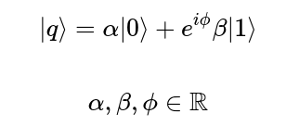

Bloch sphere
Another way to represent a qubit is the bloch sphere representation.
This is a 3D sphere of unit radius and each point on its surface represents a different state.

Slide 11

Wow! That’s quite a lot, you’re almost there!

Slide 12
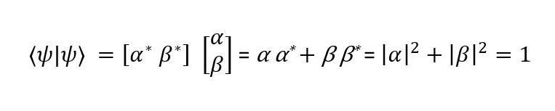
Inner product
Qubits are vectors in a 2^{n} Hilbert space
Geometrically equivalent to the dot product

Slide 13
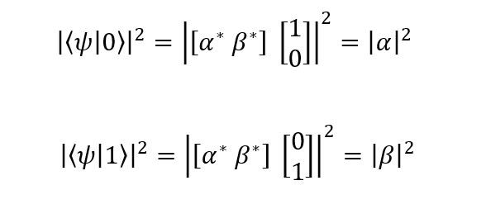
Looking at Schrödinger’s catto 🐈
How do you measure something? And how does this fit in with our trip down physics lane?
The way we measure a qubit in a state|b⟩ is to take the inner product of the qubit with the state in which you want to measure it in and take the modulus of this result and square it.
This gives us the probability that the post-measurement state of the qubit will be |b⟩.

Slide 14
Matrices and why they are important
In linear algebra, think of a matrix as an “operation” that modifies the state of a qubit
Columns of matrices as vectors
Columns are the transformed standard bases when the operation is applied on them
These operations are termed as gates

Slide 15
Gates

Slide 16
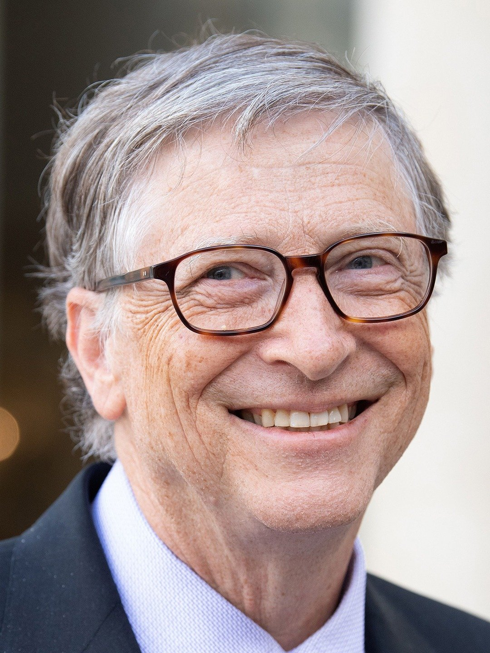
Gates
Hehe, wrong Gates (sorry, was bored)

Slide 17

Classical and quantum gates
What are the differences between the two?
Classical NOT vs classical OR, AND etc
How does it relate to the physics of information?
What are some of the equivalent gates between classical and quantum computing?

Slide 18
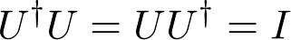
Quantum gates
These are nothing but unitary matrices that change the state of the qubit.

Slide 19
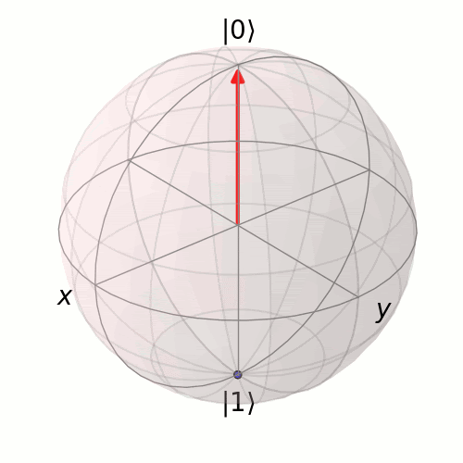
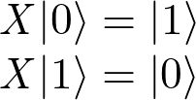
Quantum gates
Pauli X
Equivalent to the classical NOT gate
Flips the standard bases
Has no effect on the Hadamard basis
It rotates the qubit about the X axis on the bloch sphere

Slide 20
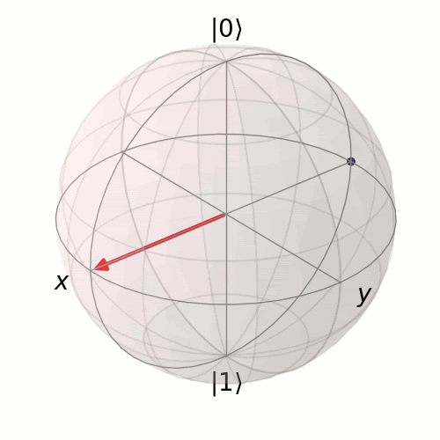
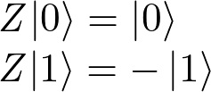
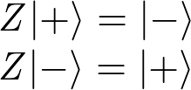
Quantum gates
Pauli Z
Similar to the Pauli X gate, this rotates the qubit vector around the Z axis.
Adds a phase of π

Slide 21
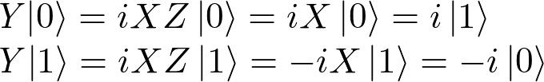

Quantum gates
Pauli Y
Similar to the Pauli X and Z gates, this rotates the qubit vector around the Y axis.
The states obtained by applying Pauli Y to the standard bases are circularly polarized states. |↺⟩,|↻⟩

Slide 22
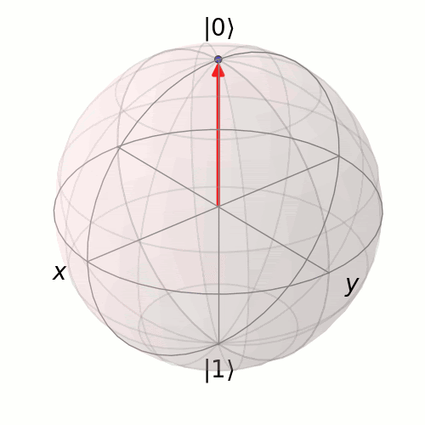
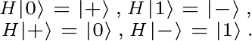
Quantum gates
Hadamard gate
Like, the Paulis, the Hadamard is also a half rotation about the Bloch sphere. However, the difference is that it rotates about an axis that is exactly between the X and the Z axes.

Slide 23
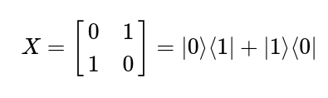
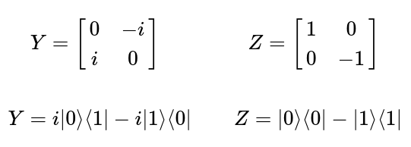
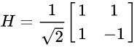
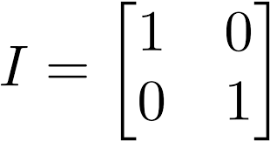
What do they look like?
Matrices!

Slide 24
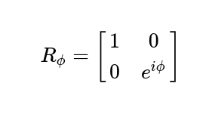
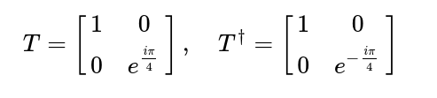
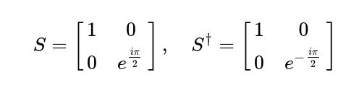
Another easy and cute gate
The R_{ϕ}-gate
Parameterized gate, needs an argument ϕ
The R_{ϕ}-gate performs a rotation of ϕ around the Z-axis
We can derive two more gates from this, T and S

Slide 25
So, how many gates have we covered so far?

Slide 26

So, how many gates have we covered so far?

Slide 27
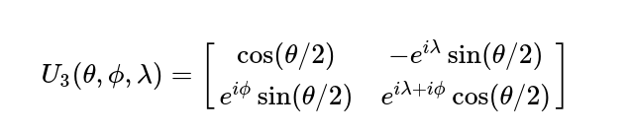
That’s wayyy too many gates to remember!
General, parameterized form of a quantum gate

Slide 28
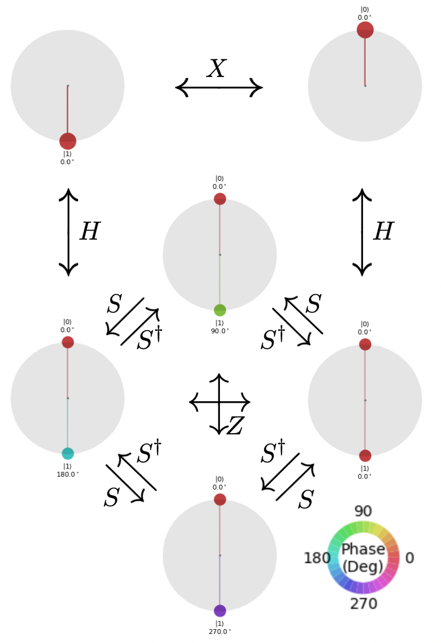
Overview of
single qubit
gate operations

Slide 29
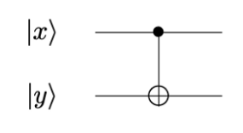
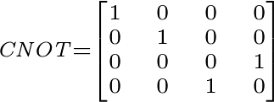
What if I want to perform operations on multiple qubits?
Controlled NOT gate

Slide 30
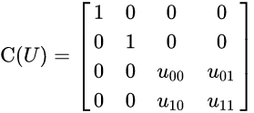
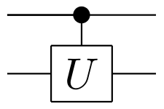
General control gate

Slide 31

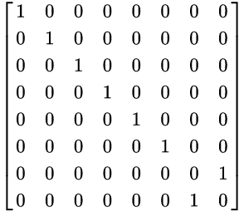
Toffoli Gate

Slide 32
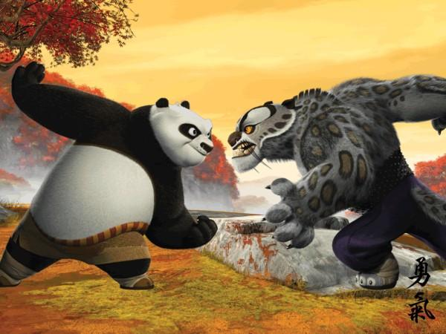

Heads or tails?

Slide 33
Rules
The coin starts with heads facing up
The first move is made by your opponent
The second move is made by you
During these moves, neither you nor your opponent can see the coin
The third move is again made by your opponent
In the end, if there’s tails facing up, you win, else your opponent wins!

Slide 34
Finer details
You can either decide to flip the coin or leave it as it is!
But remember, you can’t see the coin!

Slide 35
Finer details
|0⟩ Heads
|1⟩ Tails

Slide 36
Finer details
Flip Pauli X
No Flip Identity

Slide 37
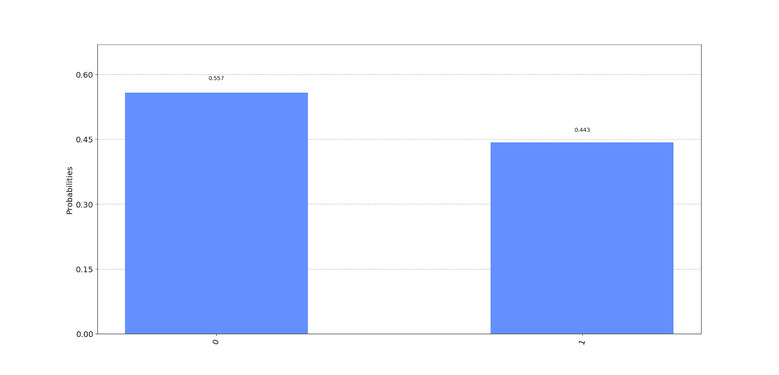
Classical opponent
What happens
if your opponent was
a classical computer?

Slide 38
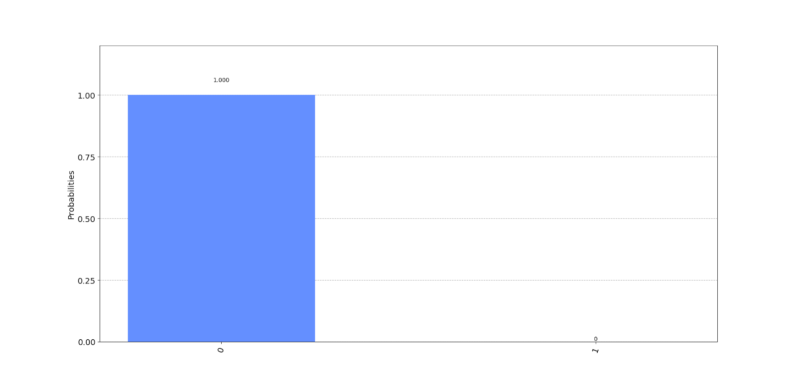

Quantum opponent

Slide 39
How?
H|0⟩ = |+⟩
H|+⟩ = |0⟩
X|+⟩ = |+⟩
X|0⟩ = |1⟩
I|0⟩ = |0⟩
I|1⟩ = |1⟩

Slide 40
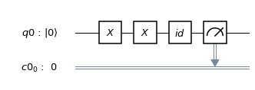
An example
Your opponent flips the coin
You flip the coin
Your opponent decides to leave it as it is
The circuit looks something like this ->

Slide 41
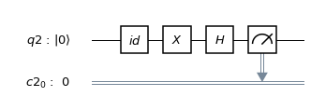
Hadamard, I choose you!
So, this is what your opponent will do if quantum in nature

Slide 42
What is QDK?

Slide 43
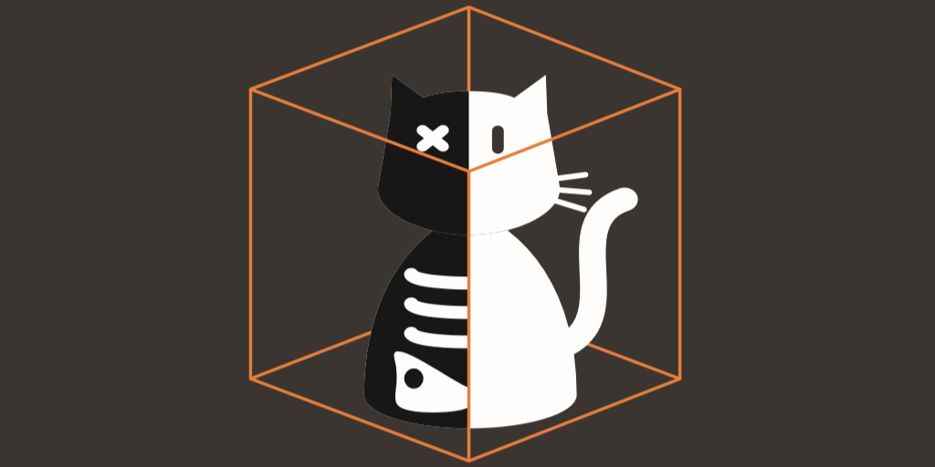
Q# is a domain specific programming language built by Microsoft from the ground up to interact with the current and future quantum hardware.
If you're familiar with either C# or F#, you will find Q# familiar to work with as it borrows heavily from those

